Slide 1


16S rRNA Microbiome Intermediate Bioinformatics Course:
Int_BT_2019
Wrap Up Session
Part 1 - Introduction
16S rRNA Intermediate Bioinformatics Course: Int_BT
Verena Ras

Slide 2

It’s only the Beginning…
Aims:
Reflect on the INT_BT course
Identify and determine how to continue utilizing the INT_BT support structures (within and across classrooms)
Provide information regarding H3ABioNet and local bioinformatics support,
as well as where to find this information.
16S rRNA Intermediate Bioinformatics Course: Int_BT
Verena Ras

Slide 3
Learning Outcomes
•reflect on the INT_BT course and provide anonymous feedback
•reflect on one’s confidence to perform particular bioinformatics actions
•be able to explain what H3ABioNet is and what tools and
services are available
•be able to name the H3ABioNet node ambassador for one’s institution, and will know his/her role
•know the bioinformatics activities and resources available
at one’s local institution
•have access to a list of ways in which they can continue to utilize the INT_BT support structures after the INT_BT course.
16S rRNA Intermediate Bioinformatics Course: Int_BT
Verena Ras

Slide 4
Logistics for today’s session
follow the workshop day plan - prompts to play pre- recorded lecture videos
Day plan available on vula
Videos will contain instructions for each activity
Stop the videos and complete the activity when prompted
Questions:
Any questions? Vula forums
16S rRNA Intermediate Bioinformatics Course: Int_BT
Verena Ras

Slide 5
Next
Watch video labeled:
Part 2
16S rRNA Intermediate Bioinformatics Course: Int_BT
Verena Ras

Slide 6
16S rRNA Microbiome Intermediate Bioinformatics Course:
Int_BT_2019
Wrap Up Session
Part 2 – The Good, the Funny, and the Frustrating
16S rRNA Intermediate Bioinformatics Course: Int_BT
Verena Ras

Slide 7

The Good, the Funny, and the Frustrating
Activity 1 (10-15 minutes)
Divide into small groups of 3-4 people (at least one staff member per group, if possible)
Each person to describe:
Memory of a moment when they felt good in the INT_BT course
Memory of something funny that happened during the INT_BT course
Memory of when they felt frustrated by something in the INT_BT course and
how they managed to overcome
that frustration
16S rRNA Intermediate Bioinformatics Course: Int_BT
Verena Ras

Slide 8
Next
Only once you have completed activity 1,
watch video labeled:
Part 3
16S rRNA Intermediate Bioinformatics Course: Int_BT
Verena Ras

Slide 9
16S rRNA Microbiome Intermediate Bioinformatics Course:
Int_BT_2019
Wrap Up Session
Part 3 – INT_BT Highlights
Introduction to Bioinformatics online course : IBT
Verena Ras

Slide 10
INT_BT Highlights
Activity 2 (15 minutes) -activity for the entire classroom, together
Move chairs into a circle
Select a scribe
Brainstorm your classroom’s INT_BT highlights
Scribe to write down all suggestions (where everyone can see them)
Select top 2-4 highlights (by voting)
Each classroom should then post the top 2-4 on the Vula forums as a reply to their ‘meet the classrooms’ post. Begin the post with
“Our highlights of INT_BT this year were
1. …, 2. …, etc.”
16S rRNA Intermediate Bioinformatics Course: Int_BT
Verena Ras

Slide 11
Next
Only once you have completed
activity 2, and have uploaded your answer to the Vula forums:
watch video labeled:
Part 4
16S rRNA Intermediate Bioinformatics Course: Int_BT
Verena Ras

Slide 12
16S rRNA Microbiome Intermediate Bioinformatics Course:
Int_BT_2019
Wrap Up Session
Part 4 – Self reflection: “How confident are you?”
16S rRNA Intermediate Bioinformatics Course: Int_BT
Verena Ras

Slide 13
‘On a scale from 1 to 5…’
Activity 3 (10 minutes):
Navigate to INT_BT Vula site -> Feedback -> Take 2 – ‘How confident are you to…’
Fill out the form
Take time to reflect on your what your answers were to these questions at the beginning of the course.
Has your confidence changed?
16S rRNA Intermediate Bioinformatics Course: Int_BT
Verena Ras

Slide 14
Next
Only once you have completed activity 3:
watch video labeled:
Part 5
16S rRNA Intermediate Bioinformatics Course: Int_BT
Verena Ras

Slide 15
16S rRNA Microbiome Intermediate Bioinformatics Course:
Int_BT_2019
Wrap Up Session
Part 5 – H3ABioNet overview
16S rRNA Intermediate Bioinformatics Course: Int_BT
Verena Ras

Slide 16
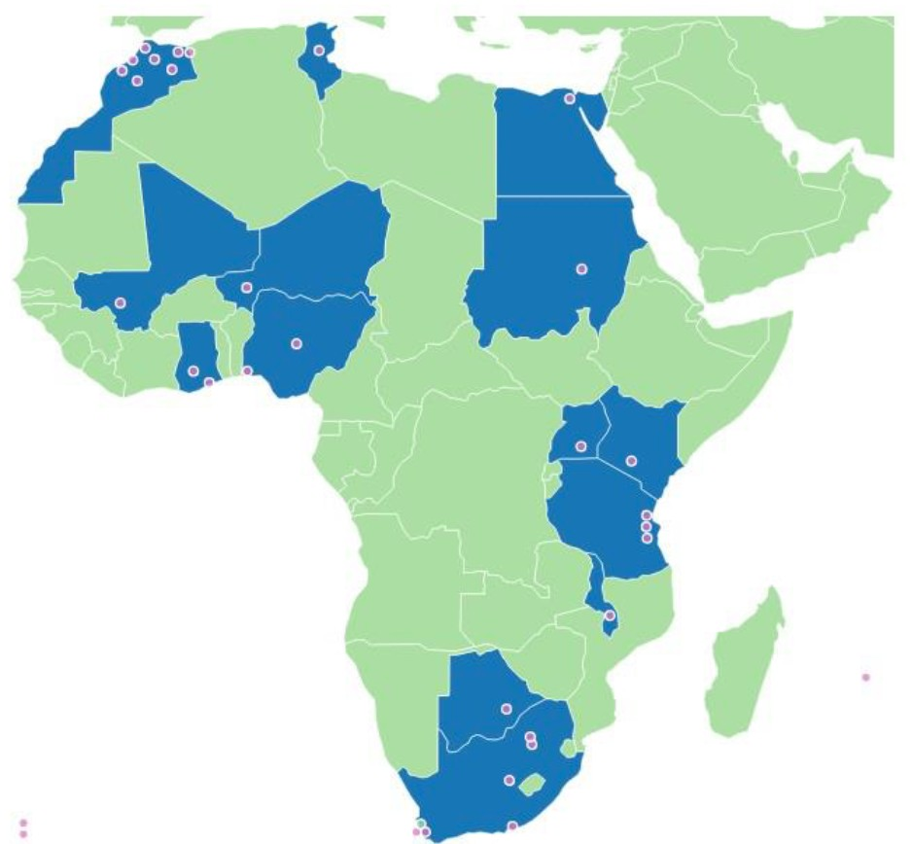
H3ABioNet
A sustainable African Bioinformatics Network
Provide bioinformatics infrastructure and support for the H3Africa consortium
Consists of nodes with different levels of bioinformatics expertise
28 nodes in 16 countries
16S rRNA Intermediate Bioinformatics Course: Int_BT
Verena Ras

Slide 17
What has H3ABioNet done?
Infrastructure and capacity development
Servers and eBioKits
Connectivity between nodes, internet connectivity
Bioinformatics help desk http://www.h3abionet.org/support?view=detail& cid=-1
Data transfer between nodes
Data storage
Training in IT, data management
Tool and resource development
16S rRNA Intermediate Bioinformatics Course: Int_BT
Verena Ras

Slide 18
What has H3ABioNet done?
Main focus areas of data analysis:
Targeted sequencing
Pathogen sequencing
Microbiome 16s rRNA sequencing
Exome sequencing
Whole genome sequencing
Genotyping arrays
16S rRNA Intermediate Bioinformatics Course: Int_BT
Verena Ras

Slide 19
Data Analysis Pipelines
Docker containers built for main H3Africa data analysis pipelines – paper in progress
Associated SOPs developed together with practice datasets - http://www.h3abionet.org/tools-and- resources/sops
16S rRNA Intermediate Bioinformatics Course: Int_BT
Verena Ras

Slide 20
Data Analysis Pipelines
SOPs and practice datasets available for:
NGS variant calling
Genome association studies
16s rRNA diversity analysis
Further SOPs under development
RNA seq
Variant annotation and prioritisation
Guidelines on server setup and general system administration
16S rRNA Intermediate Bioinformatics Course: Int_BT
Verena Ras

Slide 21
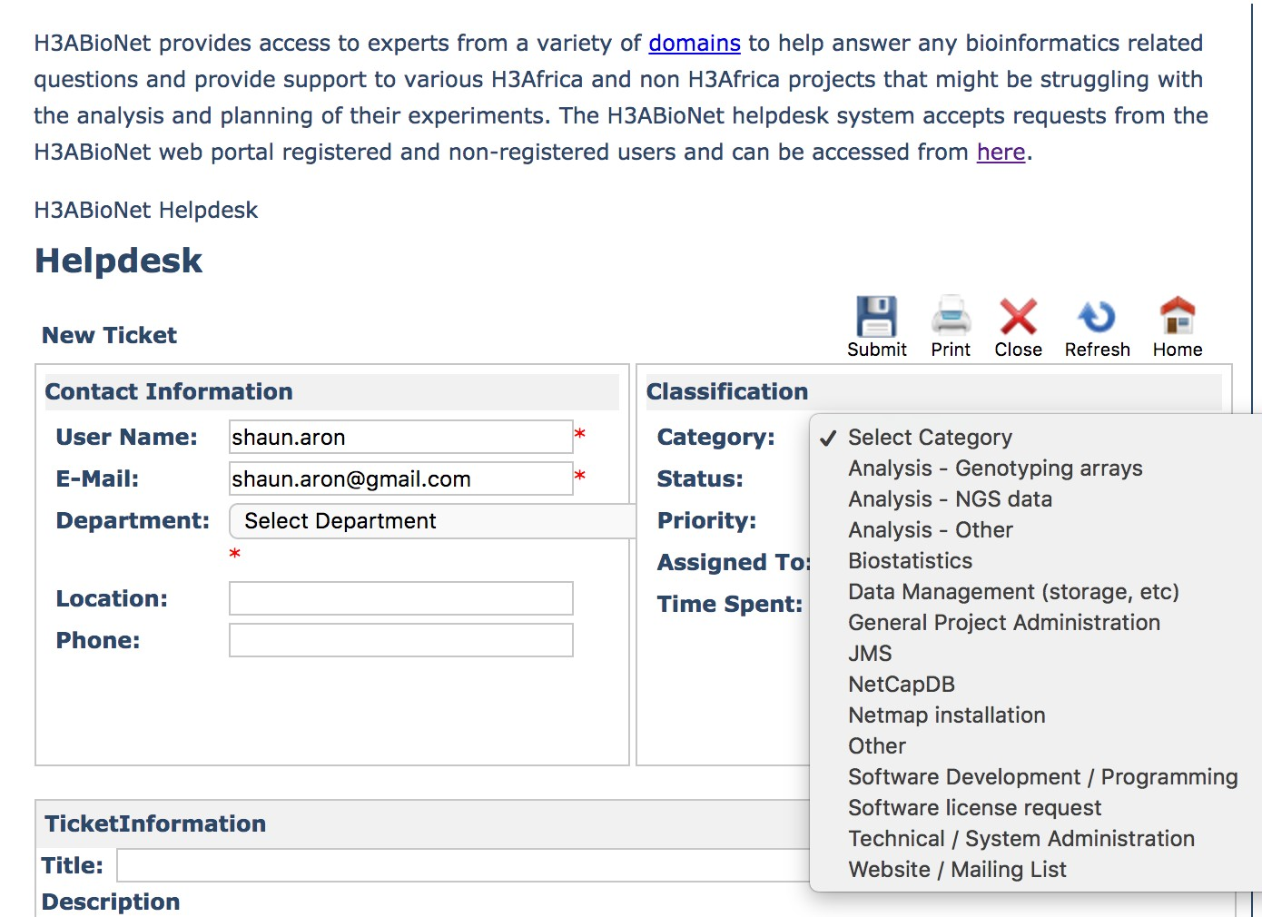
H3ABioNet Helpdesk
16S rRNA Intermediate Bioinformatics Course: Int_BT
Verena Ras

Slide 22
Training
Hosted several workshops on a range of bioinformatics topics
List of workshops available here: http://www.h3abionet.org/training-and- education/h3abionet-courses
In the process of updating and organising this resource
Linking to eGenomics catalogue
16S rRNA Intermediate Bioinformatics Course: Int_BT
Verena Ras

Slide 23

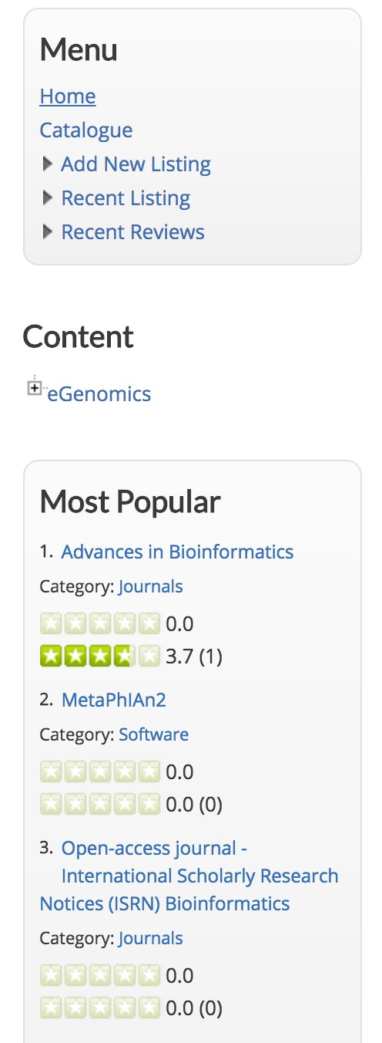
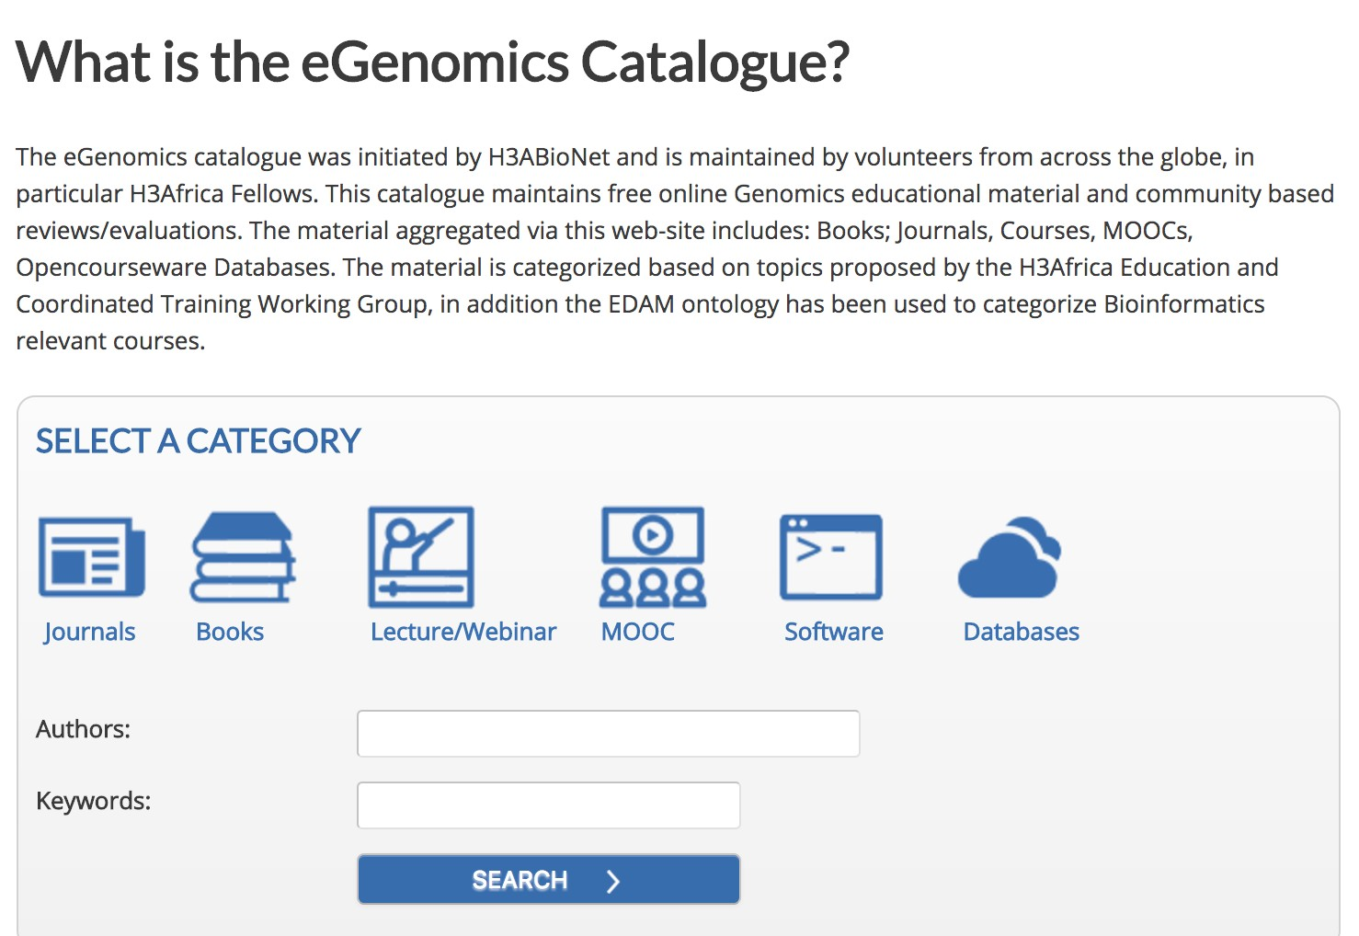
16S rRNA Intermediate Bioinformatics Course: Int_BT
Verena Ras

Slide 24
Other projects
Design of a new African genotyping array
Development of a participant recruitment database
Development of an H3Africa data archive
H3ABioNet seminar series and journal club
Workshop proposals and internships
http://www.h3abionet.org/
16S rRNA Intermediate Bioinformatics Course: Int_BT
Verena Ras

Slide 25
Acknowledgements
H3ABioNet is funded through NIH Common Fund, NHGRI grant: U41HG006941
16S rRNA Intermediate Bioinformatics Course: Int_BT
Verena Ras

Slide 26
Next
watch video labeled:
Part 6
16S rRNA Intermediate Bioinformatics Course: Int_BT
Verena Ras

Slide 27
16S rRNA Microbiome Intermediate Bioinformatics Course:
Int_BT_2019
Wrap Up Session
Part 6 – What’s happening at your institution?
16S rRNA Intermediate Bioinformatics Course: Int_BT
Verena Ras

Slide 28

Bioinformatics at your Institution
Bioinformatics expertise
Bioinformatics Software and Computational resources
Bioinformatics Activities
Where to find support and further information
What and who the Node Ambassador
16S rRNA Intermediate Bioinformatics Course: Int_BT
Verena Ras

Slide 29

Bioinformatics at your Institution
Activity 4 (30-40 mins)
Part 1:
Staff presentation
Meet the Node Ambassador
Part 2:
Q&A session
Part 3:
Summarize the main points of the presentation and add them to the Vula forums as a reply to your
classrooms ‘meet the classroom’ post
16S rRNA Intermediate Bioinformatics Course: Int_BT
Verena Ras

Slide 30
Next
Once you have completed activity 4:
watch video labeled:
Part 7
16S rRNA Intermediate Bioinformatics Course: Int_BT
Verena Ras

Slide 31
16S rRNA Microbiome Intermediate Bioinformatics Course:
Int_BT_2019
Wrap Up Session
Part 7 – Brainstorming how to stay in touch – in Adobe
16S rRNA Intermediate Bioinformatics Course: Int_BT
Verena Ras

Slide 32
Discussion in Adobe
For discussion:
What support structures exist within INT_BT classrooms?
What support structures exist between INT_BT classrooms?
For each support structure, how can we continue to utilize it post INT_BT?
Vula forums -> Wrap up Session
16S rRNA Intermediate Bioinformatics Course: Int_BT
Verena Ras

Slide 33
Next
Watch video labeled:
Part 8
16S rRNA Intermediate Bioinformatics Course: Int_BT
Verena Ras

Slide 34
16S rRNA Microbiome Intermediate Bioinformatics Course:
Int_BT_2019
Wrap Up Session
Part 8 – Feedback
16S rRNA Intermediate Bioinformatics Course: Int_BT
Verena Ras

Slide 35
Tell us what you thought of INT_BT
Activity
Feedback forms
Participants and staff – tell us what you thought of INT_BT, overall
INT_BT Vula site -> Feedback -> INT_BT course overview
A reminder about the informed consent form INT_BT Vula site -> Feedback ->
INT_BT informed consent
16S rRNA Intermediate Bioinformatics Course: Int_BT
Verena Ras

Slide 36
Next
Once you have completed the activity:
watch video labeled:
Part 9
16S rRNA Intermediate Bioinformatics Course: Int_BT
Verena Ras

Slide 37
16S rRNA Microbiome Intermediate Bioinformatics Course:
Int_BT_2019
Wrap Up Session
Part 9 – Thank You!
16S rRNA Intermediate Bioinformatics Course: Int_BT
Verena Ras

Slide 38

Thank you, All
On behalf of the IBT core team – Shaun Aron, Verena Ras, Gerrit Botha, Suresh Maslamoney, Sumir Panji, Nicola Mulder - we thank you….
Local staff
Expert trainers
consultants
Vula and Adobe teams
participants
16S rRNA Intermediate Bioinformatics Course: Int_BT
Verena Ras

Slide 39
See You Soon!
16S rRNA Intermediate Bioinformatics Course: Int_BT
Verena Ras

